Slide 1
Multilingual PII Detection and Anonymization System

Slide 2

01
Goal: Detect and redact PII
02
Architecture Overview
Presentation Overview
03
Detection Engines
04
Multilingual and GPU Support
05
Outputs and Batch Processing

Slide 3
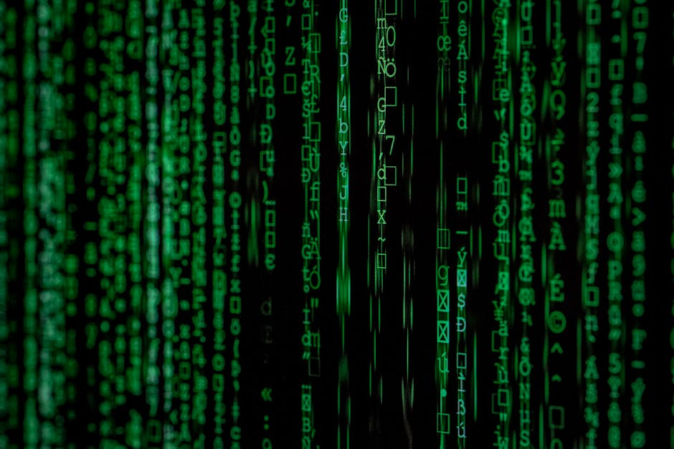
Goal: PII Detection and Redaction
Why PII Matters
Personally identifiable information (PII) must be protected to comply with regulations and safeguard user privacy in digital systems.
Detection Objectives
Identify sensitive entities like names, emails, phone numbers, and addresses across multiple languages.
Redaction Approach
Entities are masked or replaced ensuring the original context remains coherent and readable.

Slide 4
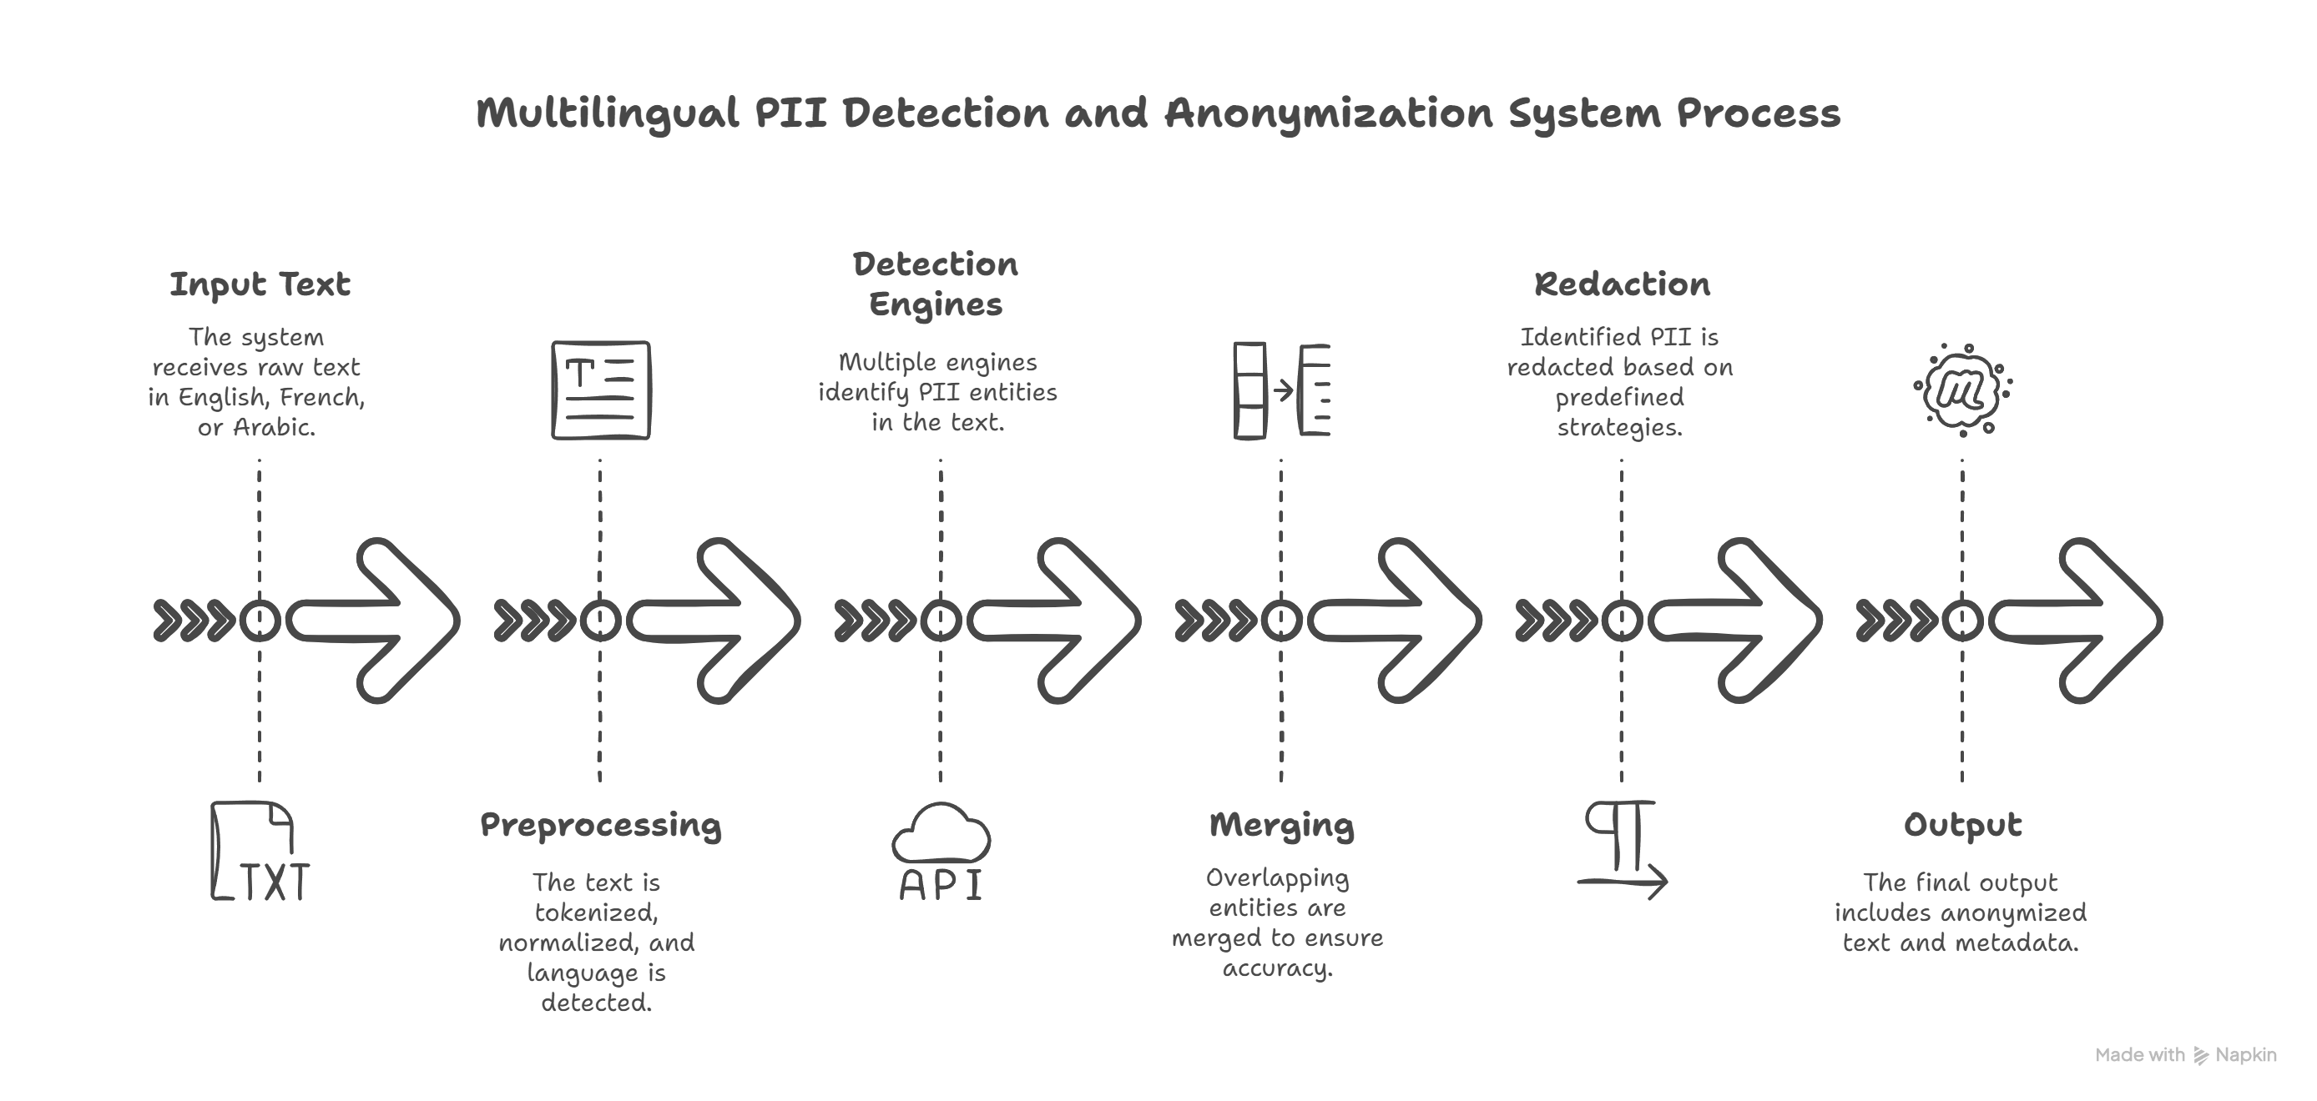
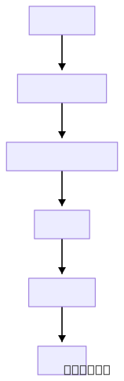
Architecture Overview Diagram

Slide 5
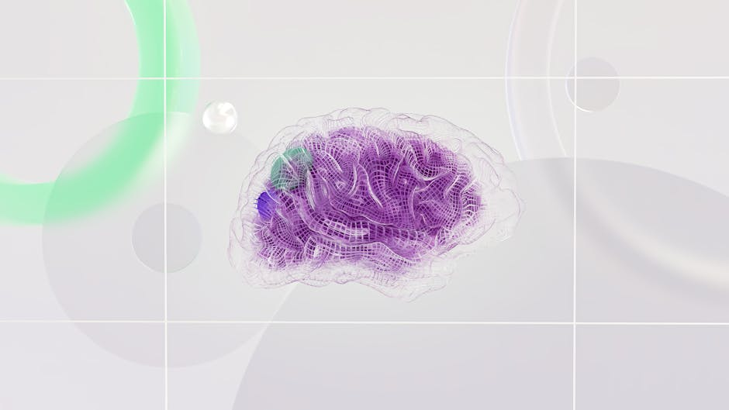
Detection Engines Overview
Presidio Analyzer
Customized patterns are used in Microsoft Presidio for efficient entity recognition and context-sensitive analysis.
NER-Based Detection
Hugging Face Transformers and spaCy models are utilized to detect complex entities using deep learning techniques.
Regex Patterns
Regex is employed for traditional entity matching like emails, phone numbers, and structured addresses.

Slide 6
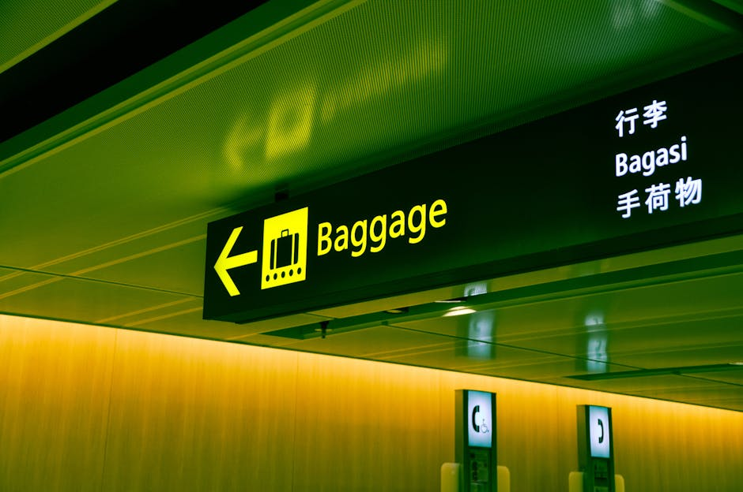
Multilingual Language Support
English, French, Arabic
Support for multiple languages enables broader deployment, ensuring detection respects language-specific nuances.
Arabic Reshaping
Special handling for Arabic script to improve entity detection with text normalization and reshaping.
French-Specific Patterns
Enhanced regex and NER models accommodate French linguistic structures and address formats.

Slide 7
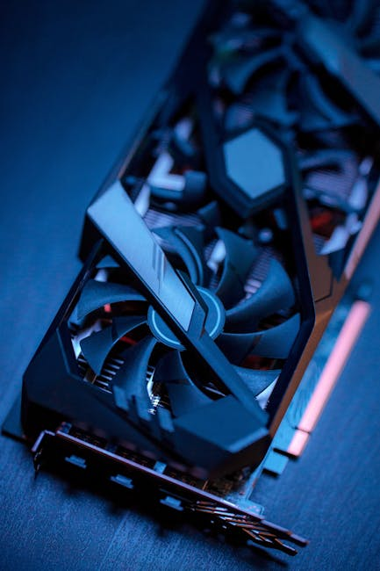
GPU Acceleration for Speed
CUDA GPU Detection
The system automatically detects available CUDA-capable GPUs and adjusts model execution to leverage GPU acceleration.
Optimization Techniques
Batch sizes, memory management, and model parallelism are tuned dynamically for performance.
Speed Improvements
PII detection tasks can achieve up to 10x faster processing times compared to CPU-only execution.

Slide 8

Entity Merging and Masking
Merging Entities
Entities detected by different engines are merged intelligently, prioritizing higher-confidence detections.
Masking Strategies
Detected PII can be masked with placeholders, or replaced contextually to maintain text usability.
Overlap Resolution
Overlap handling ensures no duplicated or conflicting redactions occur.

Slide 9
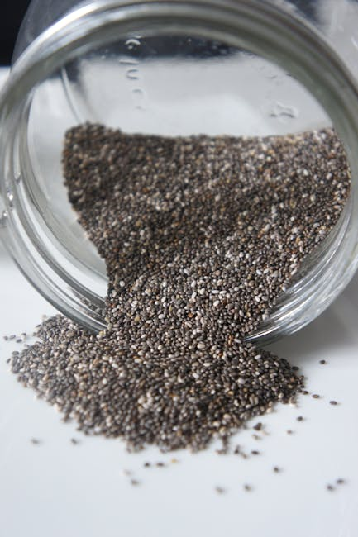
Batch Processing for Scale
ThreadPoolExecutor
Parallel batch processing is enabled using Python's ThreadPoolExecutor to maximize throughput.
High Scalability
System can handle large text corpora efficiently by distributing tasks across threads and available GPUs.
Load Management
Adaptive queueing and dynamic batch sizing optimize resource utilization for variable workloads.

Slide 10

Final Output: What You Get
Anonymized Text
Fully anonymized text retaining the original structure and coherence, without exposing sensitive data.
Entity Metadata
Detailed metadata for each detected and redacted entity, useful for audits and validations.
Processing Statistics
Comprehensive processing metrics: number of entities found, time taken, and resource utilization.

Slide 11
Future Enhancements
How can we further improve multilingual PII detection?
Conclusion and Next Steps
- Expand support to more languages (e.g., Mandarin, Spanish)
- Improve detection of complex entities (e.g., contracts, invoices)
- Integrate with real-time data streams

